Slide 1
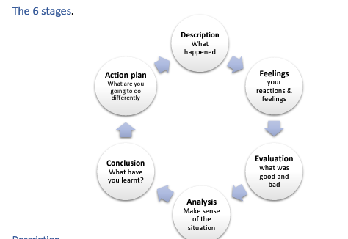
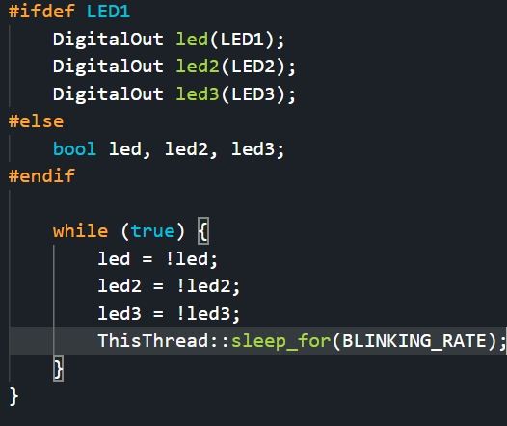
Embedded Systems Lab Worksheet
Student Name: Zeyad
ID Number: 23077460
Lab. Number: 1
Date: 30/01/2025
Lab Title:
Outline of Approach (Description of Tasks)
Itemize all key steps you took to build the required embedded system in a clear, logical and organised format.
1.Make the other lights turn on
2.Make them blink separately
3.Make them blink at the same time for 300ms
4.Create a pattern to make them turn on at separate times for different lengths of time
5.Make the led’s blink for 200ms separately then after 5 times keep led1 on while the rest are off
.
.
Reflection (Not more than 200 words)
I created a simple blinking light code using the board LED’s, it was a good experience learning how to use a new board and a new coding language and made me excited for the next few weeks.
The good was the LED code was working properly, the blinking rate variable was a good addition allowing me to input the numbers easily, the counter part of the code was a little confusing but it was easily understood later on.
To analyse the situation, the blinking LED code was simple and easy to understand allowing me to understand the basics of C++ coding and the MBED studio.
I have learned how to send data to the board using the digital out and how to use the != sign to make the ‘not equal’ function.
My action plan for next lab is to make my own variables and digital out instead of taking the code from the tutorial code.
Results for Part:1
(Input only lab results, Git-hub code link, Flow chart, calculations or picture evidence of simulation/circuits/figures obtained).
All figures should be captioned with relevant title and a brief description to present the essential details).
The led’s 2 and 3 are defined and outputted.
References
Reference guide here

Slide 2
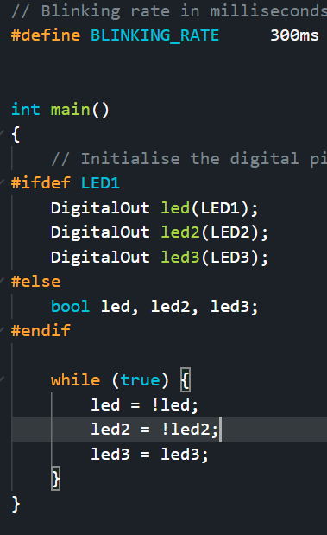
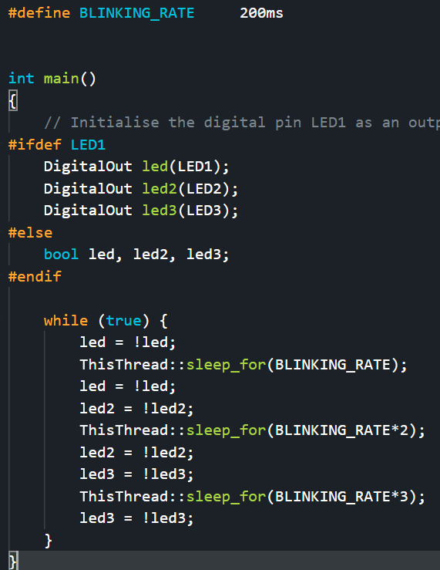
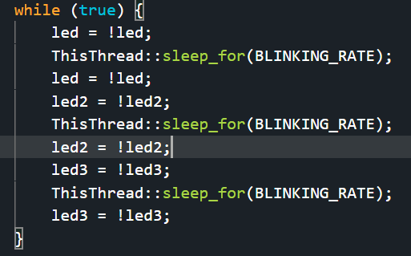
Results for Part:2
(Input only lab results, Git-hub code link, Flow chart, calculations or picture evidence of simulation/circuits/figures obtained).
All figures should be captioned with relevant title and a brief description to present the essential details).
While the thread is asleep the led is on and when the LED is turned off with led = not led the next led is then gone through the same code for 500ms on and off.
Results for Part:3
(Input only lab results, Git-hub code link, Flow chart, calculations or picture evidence of simulation/circuits/figures obtained).
All figures should be captioned with relevant title and a brief description to present the essential details).
The time is changed to 300ms and the sleep time is given only once for 300ms.
Results for Part:4
(Input only lab results, Git-hub code link, Flow chart, calculations or picture evidence of simulation/circuits/figures obtained).
All figures should be captioned with relevant title and a brief description to present the essential details).
By multiplying the blink timings by 2 and 3 I can make them each blink at different times for 200ms,400ms and 600ms

Slide 3
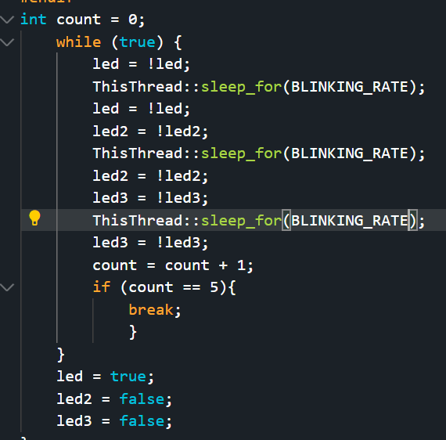
Results for Part:5
(Input only lab results, Git-hub code link, Flow chart, calculations or picture evidence of simulation/circuits/figures obtained).
All figures should be captioned with relevant title and a brief description to present the essential details).
By adding a counter we can count how many times it has been blinking for and then we can use “break” to stop the while loop and keep the led1 on while making the rest off.
Results for Part:
(Input only lab results, Git-hub code link, Flow chart, calculations or picture evidence of simulation/circuits/figures obtained).
All figures should be captioned with relevant title and a brief description to present the essential details).
Results for Part:
(Input only lab results, Git-hub code link, Flow chart, calculations or picture evidence of simulation/circuits/figures obtained).
All figures should be captioned with relevant title and a brief description to present the essential details).

